Slide 1


™
PERSONAL EMERGENCY ALERTING

Slide 2
™
An alternative program to establish ‘Early Warning for All’ as a self-sustaining feature of personal telecommunications.

Slide 3

™
What is PERSONAL EMERGENCY ALERTING ?
The ability for emergency authorities* to select and connect with ‘At-Risk’ population groups using wireless devices; commonly owned and carried by over seventy percent of the global population, Utilizing the transceiver grids of all personal telecommunication network operators.
* global bodies such as WMO, Red Cross, OCHA, Interpol as well as national and local emergency Management agencies.

Slide 4
™
What is UPSEN
UPSEN is a SELF-FUNDED fully automated Service Utility that permits personal telecommunication OPERATOrs to passively acquire and broadcast an unlimited scale of emergency alert data files to the wireless devices operating in targeted geographic cell locations.
The automated system utilizes artificial Intelligence to vastly reduce latency by predicting imminent changes in threat situations (i.e. hurricanes, wind driven fires) and verification of alert proposals by scanning an unlimited scale of validating sources.

Slide 5
™
UPSEN Is:
Needed ( UN EW4A )
Proven ( technologies deployed in nearly 30 countries )
Self Funded ( not reliant on industry or government funding )
Administered by the Global Personal Telecomm Networks; (not their Regulators)
ALL WIN – every stakeholder profits from UPSEN deployment
Networks are fairly compensated
Governments do not pay
Transactors are commissioned
ALL HUMANITY BENEFITS

Slide 6
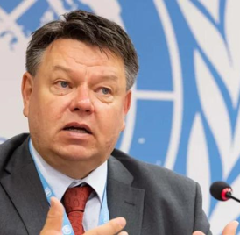
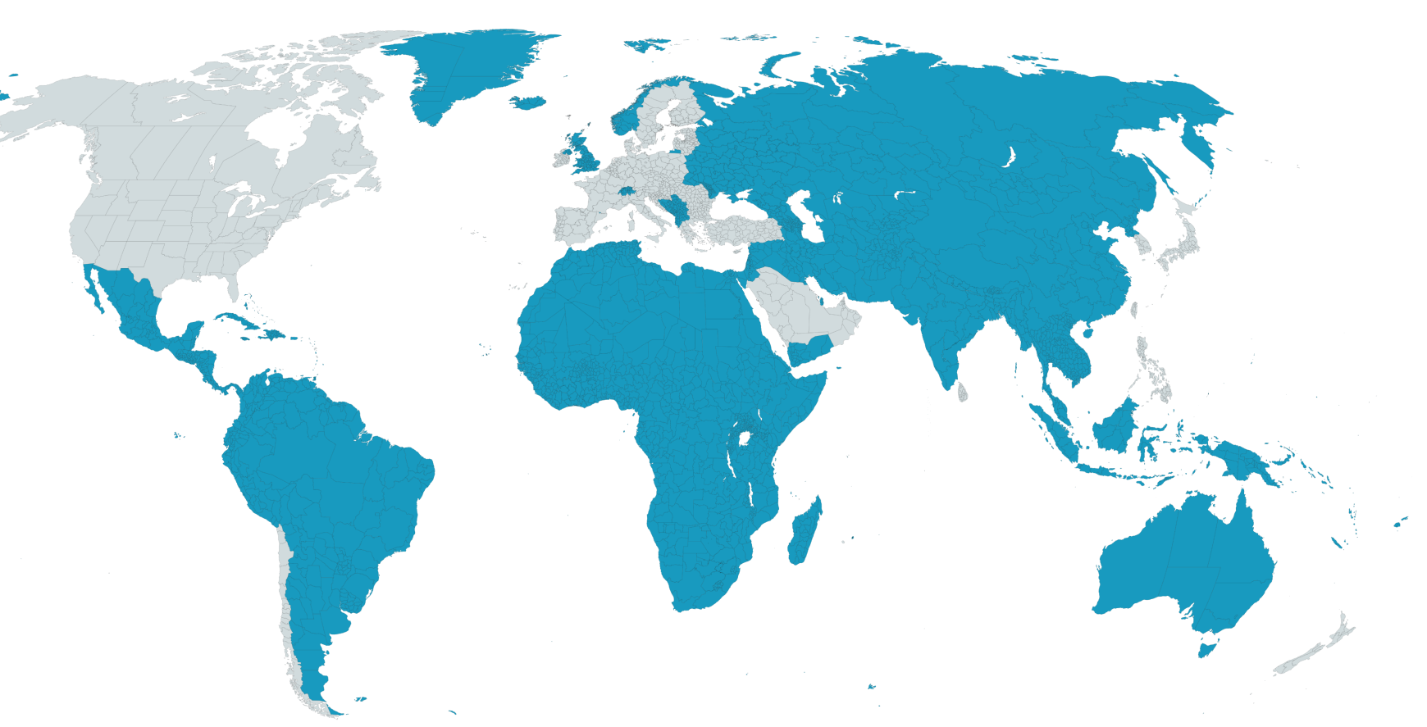
The Global Emergency Alerting Shortfall 6 billion people left vulnerable
v
“Early warnings save lives and provide vast economic benefits. Just 24 hours' notice of an impending hazardous event can cut the ensuing damage by 30 per cent. Such progress is only possible with advances in telecommunications and connectivity.”
Prof. Petteri Taalas
Secretary-General
Over 80% of the world still lacks access to effective mass notification systems
For Every
Returns
$1
$9.5
invested
in EWS
in average savings
Notes:
Slide 1 Problem: "The Global Emergency Alert Gap"
Describe the problem: "Over 80% of the world lacks access to coordinated emergency alert systems."
Highlight the consequences of this gap: Lives lost, economic losses, and lack of preparedness.

Slide 7
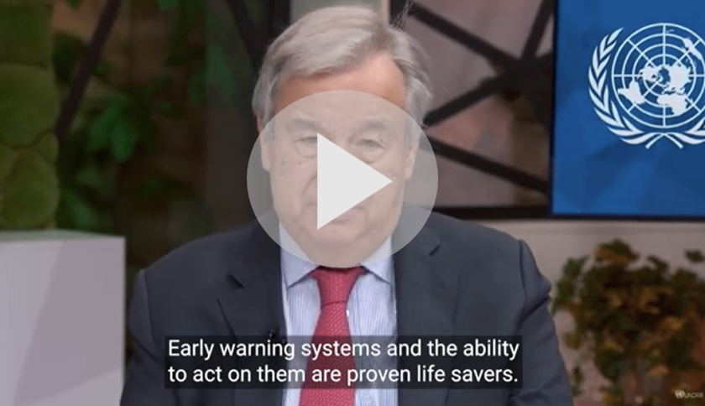



Aligned with UN’s “Early Warnings for All Initiative”
Global Alerts introduces UPSEN to fulfill “call to action”
UN & WMO Endorsement
Gen 2 systems endorsed by the United Nations and World Meteorological Organization for effective early warnings.
Global Commitment
Committed to extending early warning capabilities to majority of people without access.
Opportunity
Collaborating with global organizations to ensure widespread early warning coverage.

Slide 8
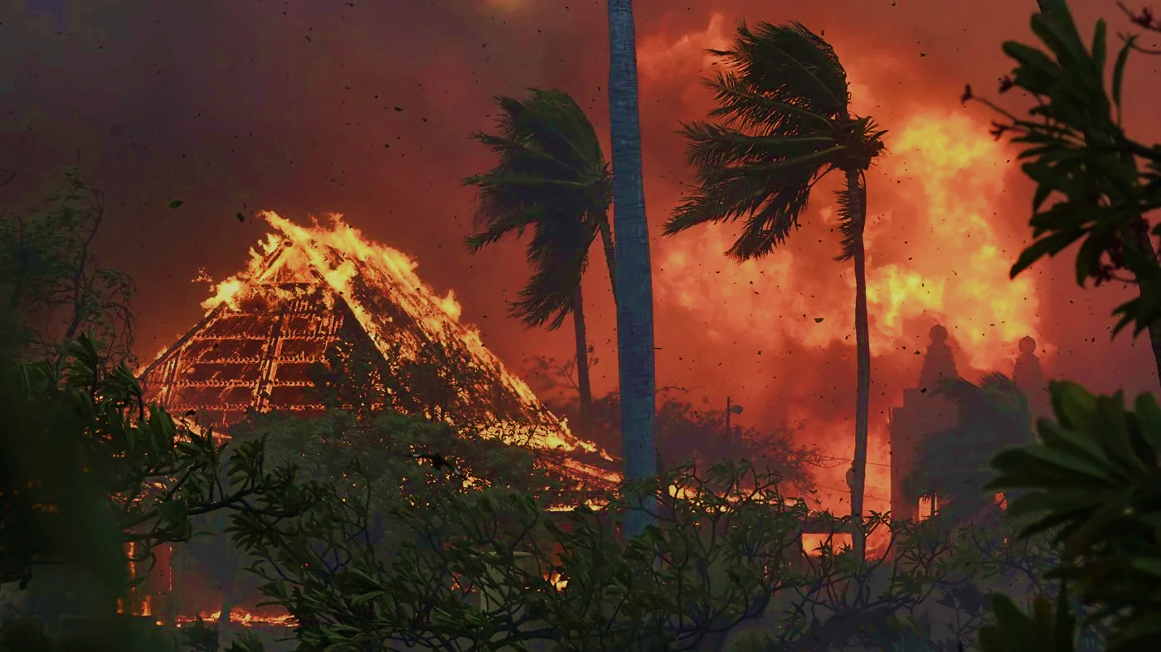


Global Disasters in Numbers
Average (2003-2022)
64,150
$196bn
86
Deaths
Economic Damages
Wild Fires
Source: 2022 Disasters in Numbers, EMDAT - Centre for Research on the Epidemiology of Disasters 2022
Notes:
Industry information

Slide 9

2023 Global Disasters in Numbers
86,473
$203bn*
264
Deaths
+35%
Economic Damages
+ 4%
Wild Fires
+300%
Source: 2023 Disasters in Numbers, EMDAT - Centre for Research on the Epidemiology of Disasters 2023
* Numerous events have not yet been calculated
Notes:
Industry information

Slide 10
The UPSEN Program
defines an alternative system and revenue model for deploying ‘Personal Emergency Alerting ’ as a global feature of personal telecommunications.
The program leverages the economic and technical benefits of a passive data syndication utility and a self-funding business model to financially reward ‘Participating Distribution Networks’ that provide Universal Public Service Emergency Notification service.
Notes:
Showcase key team members with their expertise and accomplishments.

Slide 11
Economic Challenges
Due to the cost of cellular broadcast emergency messaging, ‘gap’ nations, have not previously entertained CB implementation.
This fact has limited the market for this revolution in disaster risk reduction to only the economically advantaged nations, excluding over eighty percent of the wireless population, many in the regions most vulnerable to short-time natural and manmade threats.
UPSEN must be revenue-sustained
UPSEN cannot rely on general taxation
UPSEN cannot require trained staffing
Distribution networks must be adequately compensated
UPSEN cannot rely on data file maintenance
Funding cannot be per-message based
Standup investments must be underwritten
.
Notes:
Showcase key team members with their expertise and accomplishments.

Slide 12
Political Challenges
UPSEN must maintain national sovereignty and security.
The UPSEN ‘Pull-Data Enforcement Agent’ is programmed to exclude prohibited content and information.
UPSEN must have international agency endorsements
b) A general population tax base cannot justifiably finance a program that can only benefit the wireless population segment
c) System selection and acquisition can be highly politicized
d) Jurisdictions lack independent assessment and technical resources
e) UPSEN must respect and guarantee national sovereignty and oversite
Notes:
Showcase key team members with their expertise and accomplishments.

Slide 13
Global Alerts - Leadership
The same team that introduced the world to Gen 1 of Cell Broadcast Mass Messaging
Dan Pacholik, CEO & Director
Visionary CEO behind Global Alerts with a pioneering background in Cell Broadcast Technologies implemented in more than 20 countries. Renowned for his work in GPS-based fleet tracking in the 90s, Dan brings over two decades of experience with SaskTel including securing low-earth-orbit satellites for exclusive cellular coverage expansion and numerous tech start-ups over the last 25 years.
Shibu Abraham, CPA, Chief Financial Officer
With over 17 years of experience, Shibu has navigated a diverse career path, including roles in CFO, Project Management, Product Management, Business & Data Analysis, Business Process Management, PMO, and Back Office Outsourcing and Operations within leading global banking industry.
Brenda Scott, Director of Business Operations
Over her impressive 22-year career, Brenda has been a driving force in aiding start-up companies. She consistently upholds the highest standards of corporate governance, compliance, and regulatory filings for both private and public entities. Brenda's expertise lies in recommending and guiding changes and enhancements in software creation and development, particularly in the domains of Emergency Response and VoIP Telephony Services.
Mark Wood, Chief Technical Strategist
A recognized authority in Cell Broadcast technology, Mark has a proven track record in UN-ITU collaboration, consultancy in South America, and advisory roles for the UK Government. His extensive experience in promoting Cell Broadcast technology dates back to 1997.
Elysa Jones, Chief Standards Officer
An international authority in Emergency Data Messaging, Elysa holds leadership roles in IAEM, focusing on data requirements for emergency management. She actively promotes information sharing across diverse domains, with a strong emphasis on emergency communication and public safety.
Notes:
Showcase key team members with their expertise and accomplishments.

Slide 14

™
The UPSEN platform is developed, supported and maintained by Global Alerts Corp. under exclusive license from the Telecom Industry established and maintained non Profit Alliance. (UPSEN OneWorld)

Slide 15
THANK YOU!
Visit our Website
www. globalalertscorp.com
and learn more about our mission
Contact Dan Pacholik, CEO
danp@globalalertscorp.com
Your support helps us build a safer world for all!

